Slide 1

Post Graduation diploma project
PG-DAC
​
Learning Management System
​
Submitted By
​
Shailesh Agarmore 230343020005
Sushil Chaudhari 230343020023
Pranav Chirame 230343020024
Shantanu Mundhe 230343020060
​
Guide By : Dipali Jadhav

Slide 2
AGENDA
Introduction​
Architecture
​ER Diagram
Functionality
Technology platform used for project
User roles and responsibilities
Details of contribution of each team members
Use of GitHub
Future Scope
Conclusion

Slide 3
Introduction
1.Purpose of Project
The project provides an online platform for Manage Leaning System of any campus/school.
2. Need
The main motive to develop this Learning Management System to tract daily record and schedule the daily routine of campus.
3.Benificiaries of Project
The Project will be beneficial for Teacher and as well as Students to track daily schedule.

Slide 4
Project Architecture
Used for
User interfacing
Basic data validation
Used for
Server side validation
Response handling
Business Logic
Database operations
Used for
Permanent data storage
Database level validation
Database access using stored procedures
Front end Layer
Server Layer
Technologies used
HTML, CSS
JavaScript, jQuery
ReactJS
JSON
Database Layer
Technologies used
Spring boot
Hibernate
Technologies used
MySQL

Slide 5
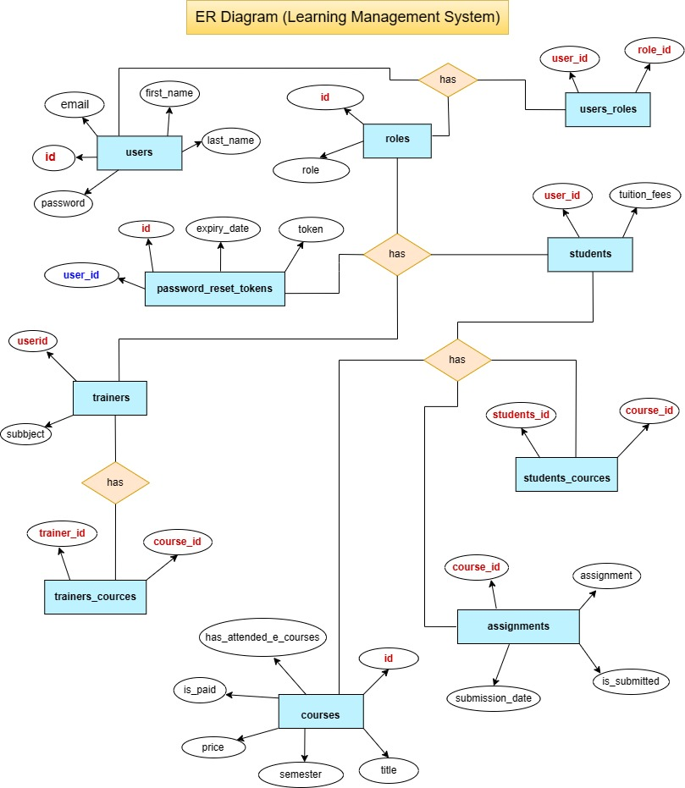

Slide 6
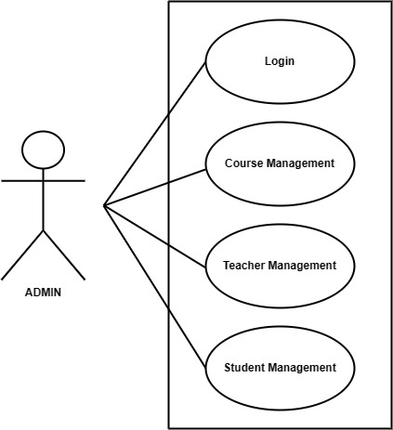
Functionality

Slide 7
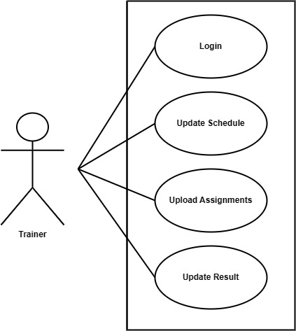

Slide 8
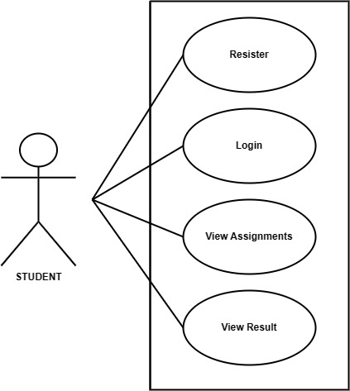

Slide 9
Technology platform used
Spring Boot Maven:
Java-based framework for fast application development with built-in tools. Build tool that automates tasks like compilation and dependency management.
MySQL:
Open-source database system for storing and managing structured data.
ReactJS:
JavaScript library to build dynamic user interfaces for web apps.
JSON (JavaScript Object Notation):
Lightweight data format for easy exchange between server and web app.
HTML/CSS:
Stylesheet language to design and layout HTML elements.
Bootstrap:
Front-end framework for creating responsive web designs efficiently.

Slide 10
Reason :
HTML,CSS and JavaScript are used for frontend part for static web pages.
React JS is used for rendering the dynamic web pages and to create a single page application where only particular part of web page is rendered without altering complete web page.
Spring boot is used for server side processing wherein in connection with database is established from server and required data is manipulated and sent to client side.

Slide 11
User roles and responsibilities
User Roles :
There are four most important roles assigned to users. Like Admin User, Artist User, Customer User, and Corporate User.
Admin : User creation, permissions, reports generations, and management etc.
Trainer : Will add course related information and like assignments daily schedule and upload online test.
Student : Will be able to see the assignments, performance and result.
User Case According to roles :
Admin : Allowing access to user, track reports etc.
Trainer : Upload daily schedule and course material.
Student : Can see all the course material and daily schedule.

Slide 12
Details of contribution from each team member
Shantanu Mundhe :- Implemented the Admin use case, Login / Logout Frontend Design and Backend.
Sushil Chaudhari :- Implemented the Teacher use case, Student use case , Signup / Registration and Bootstrap Styling for Home UI Frontend Design and Backend .
Shailesh Agarmore :- Implemented Student use case , Database and Documentation.
Pranav Chirame :- Implemented Database Design and Project Report.
Stages at which Coordination was needed
Most of the coordination was needed when complete UI needed to be rendered using React,
Every one worked together for designing the database

Slide 13
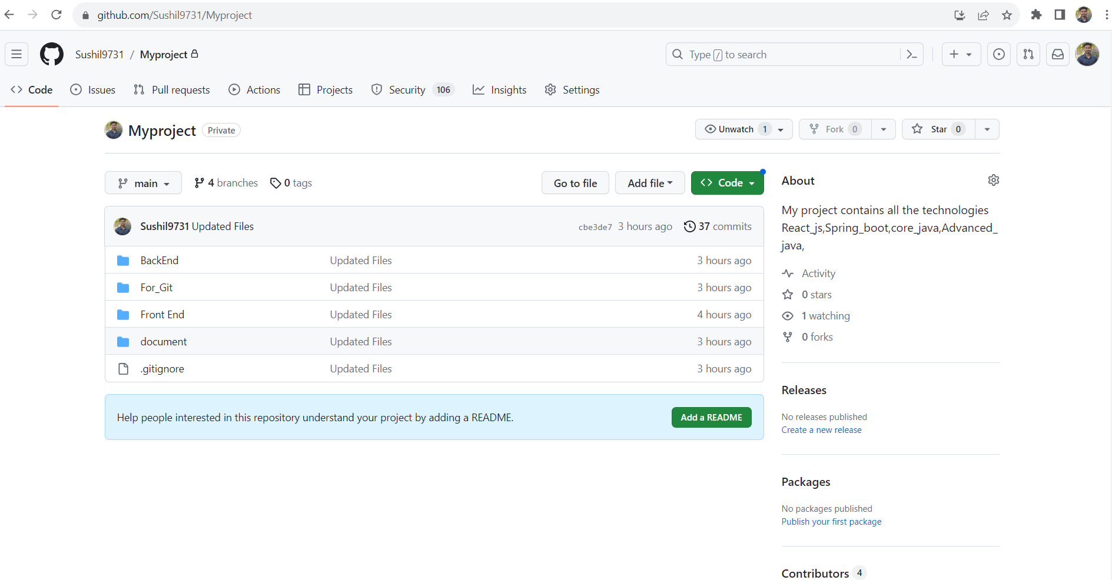
Use of Github
GitHub Link : https://github.com/Sushil9731/Myproject.git
​

Slide 14
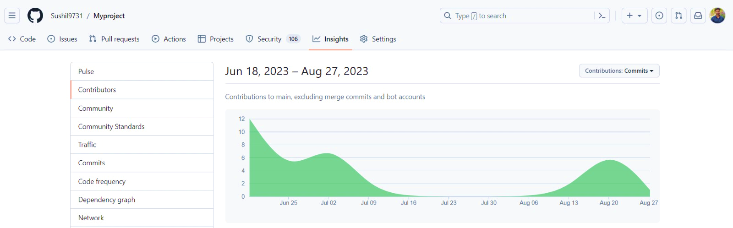

Slide 15
future scope
Future Scope:
In the future, we can make our project even better by using React JS and Bootstrap together. This will help us improve how the project looks and how users interact with it. We can make the project more attractive and easier to use by enhancing the designs and adding interactive elements.
Also, we can work on the important parts of the project to make them work even smarter. By using Spring Boot and React JS more, we can add more functionalities using crud operations if more time and resources are provided. This may include functionalities of teacher to add submission tasks and attendance reports of students. On similar lines functionalities of students can be improved too.
So, in the end, the future of our project is about making the application more and more practical in terms of user inter-action and achieve the goal of ease of learning. And by focusing on the important parts, we can use technology to make our project suitable for multiple educational institutions.

Slide 16
Conclusion
Challenges you faced :
There were many challenges that we faced like finding a write path to start with, exploring the technologies beyond the horizon of our course and UI part Etc.
Finalizing Database Design.
Implementing Functionality of Admin and Teacher.
Consensus of all members on styling and UI of Frontend.
Merging and collaborating the team work.
2. Things Learnt :
We have learnt to efficiently distribute the task within the team. We have learnt to combine all the dynamic stack of technologies together to create a fully functional software.
3. Overall Experience :
Overall experience was very practical oriented and highly knowledgeable and definitely it will helps a lot in future point view.

Slide 17
THANK YOU

